Slide 1
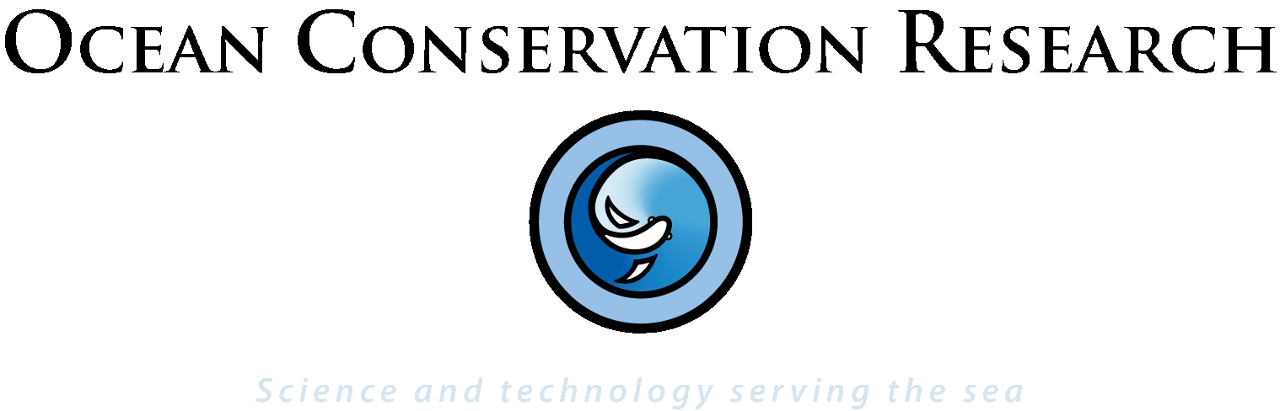
Modeling sound fields generated by multi-nodal communications networks found in underwater industrial settings
Michael Stocker

Slide 2
Industrialization of the Ocean
As we industrialize the ocean the probability of simultaneous noise exposures from various equipment increases.
But regulatory modeling typically accounts for individual sound sources in insulated settings.

Slide 3
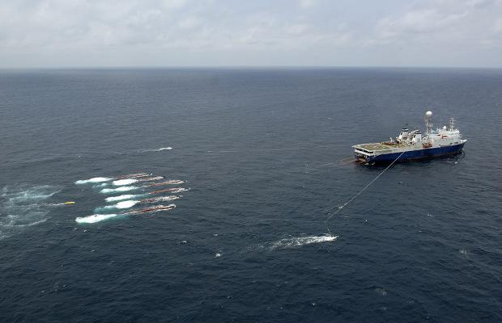
Industrialization of the Ocean
This perhaps makes sense in large operations where there is a dominant source of sound under a specific mission:
Dufour-Marco -Total

Slide 4
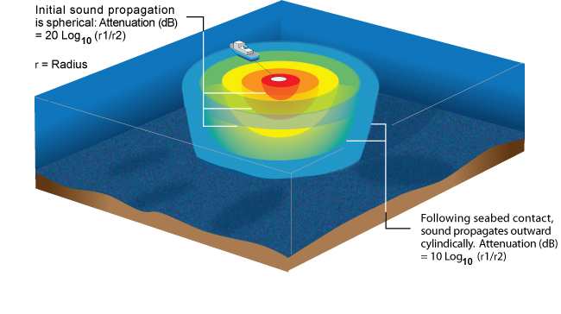
Industrialization of the Ocean
This perhaps makes sense in large operations where there is a dominant source of sound under a specific mission:

Slide 5
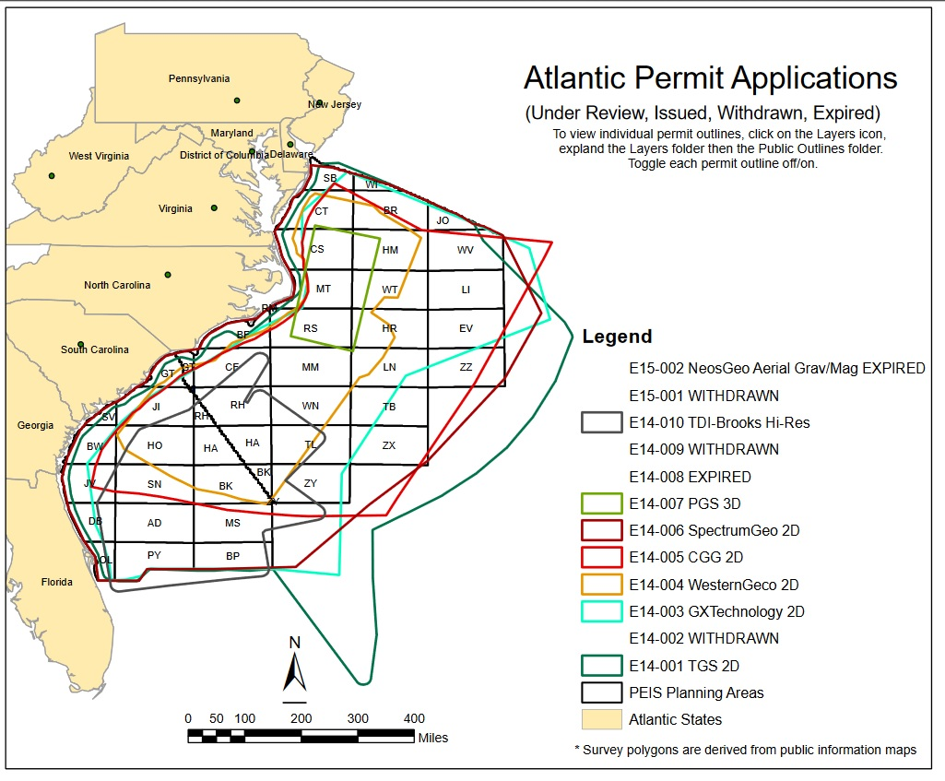
Industrialization of the Ocean
But multiple, concurrent operations need some accounting for simultaneous noise exposures.

Slide 6
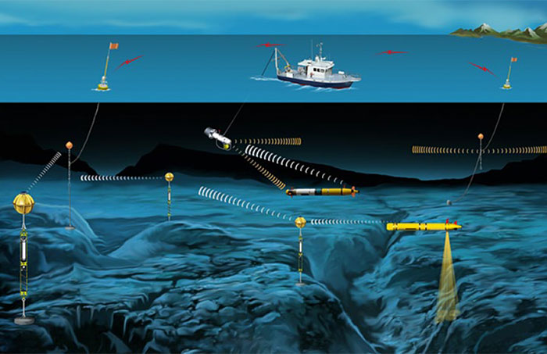
Industrialization of the Ocean
This is particularly the case when the equipment or operations is designed to work concurrently with other equipment – such as in multimodal communication networks.
WHOI Center for Marine Robotics

Slide 7
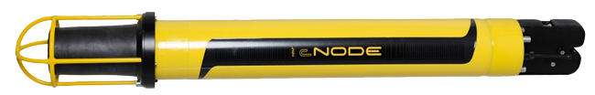
Industrialization of the Ocean
Our example: Kongsberg cNODE transponder:
Operating frequency: 30kHz
Operating level: 206 dB re: 1 uPa
Use: Orientation beacons

Slide 8
The math:
Common propagation models:
Spherical propagation loss (PL):
PL= 20Log₁₀(p_{s}/p_{ref})
“Cylindrical” propagation loss (PL):
PL= 10Log₁₀(p_{s}/p_{ref})
(when the expanding wave-front propagates within a bounded field – the sea surface and the sea floor)

Slide 9
The math:
Common propagation models:
Low frequency (f<250Hz) attenuation due to absorption is negligible – typically 0.1dB/km.
High frequency dependent sound absorption coefficient in seawater is largely influenced by the chemical “relaxation” processes of the medium due to the concentration of Boric acid (BH3O3) and Magnesium sulphate MgSO4

Slide 10
The math:
High Frequency propagation loss through absorption:
The variables were empirically derived by Francois and Garrison (1982)

Slide 11
The math:
High Frequency propagation loss through absorption:
…and simplified by M. Ainsley and McColm in 1998:

Slide 12
The Regulations:
NMFS regulatory thresholds for noise exposure.
(Pre 2016 “Level A Hearing Groups” guidelines for simplicity sake)
“Level A” physiological impacts: 180dB
“Level B” impacts for impulse exposure: 160dB
“Level B” impacts for continuous exposure: 120dB

Slide 13

The Results:

Slide 14
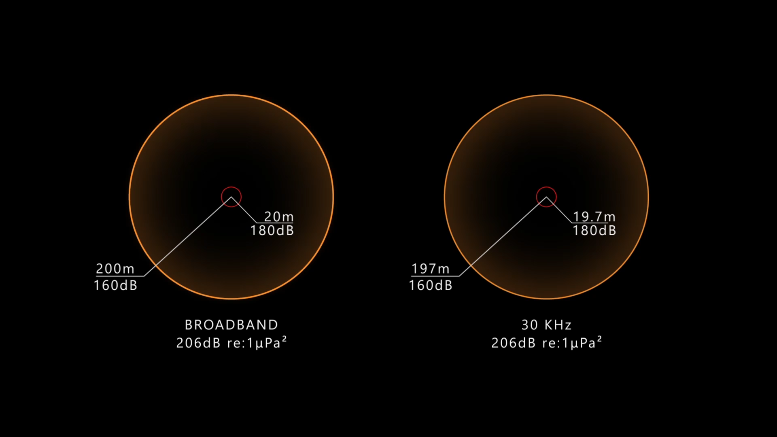
The Results:

Slide 15
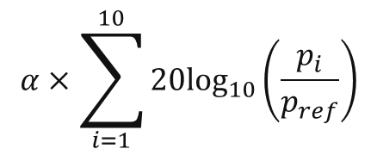
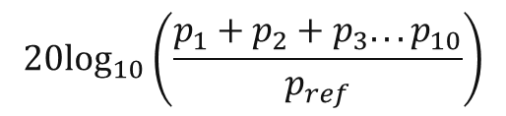
Multiple sources math:
Summing the noise sources:
Multiple sources:
$$20\log_{10}\left(\frac{p_{1}+p_{2}+p_{3}...p_{10}}{p_{ref}}\right)$$
…with high frequency absorption coefficient:
$$α×\sum_{i=1}^{10}{20\log_{10}\left(\frac{p_{i}}{p_{ref}}\right)}$$

Slide 16
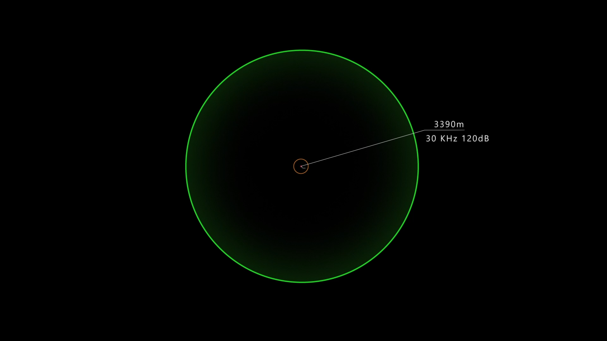
The Array:

Slide 17
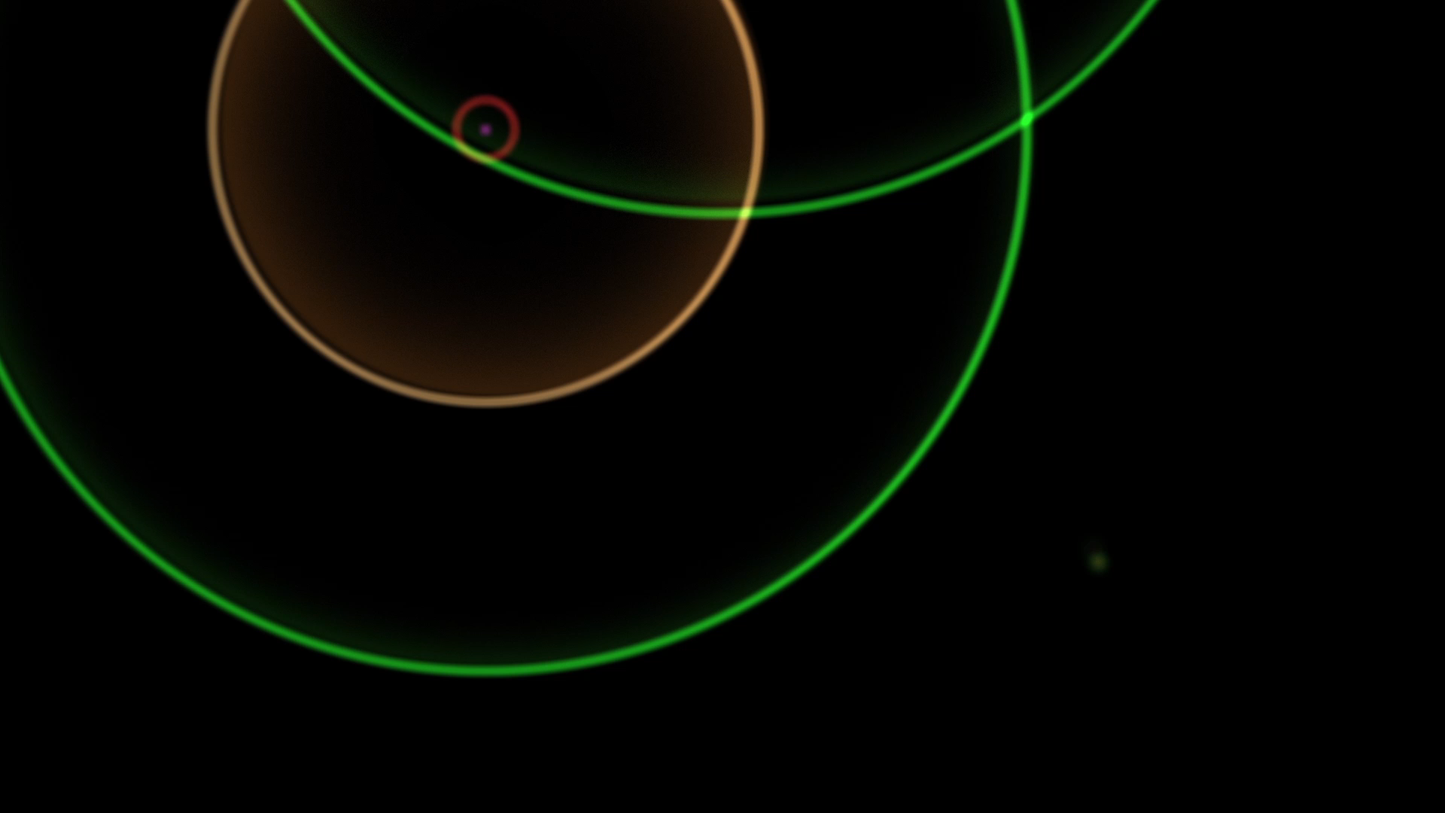
The Array:

Slide 18
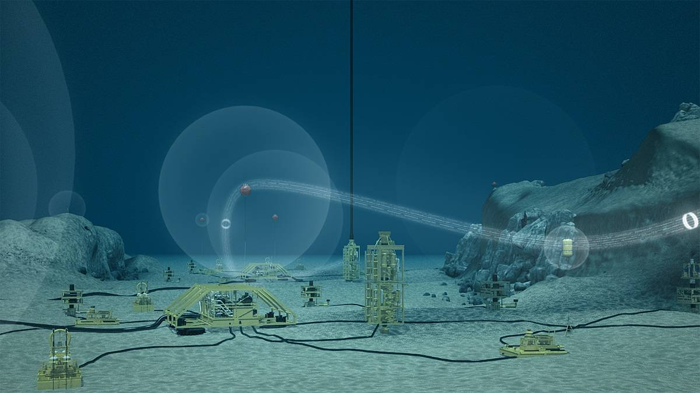
Why is this important?
Autonomous equipment is just beginning to do our bidding in the sea.
Nautronics Sub-sea communications network

Slide 19
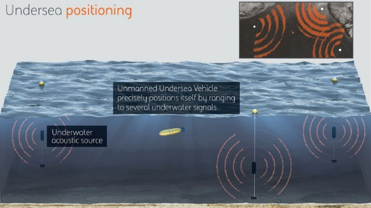
Why is this important?
DARPA is proposing a global ocean acoustical GPS
POsitioning SYstem for Deep Ocean Navigation (POSYDON)

Slide 20
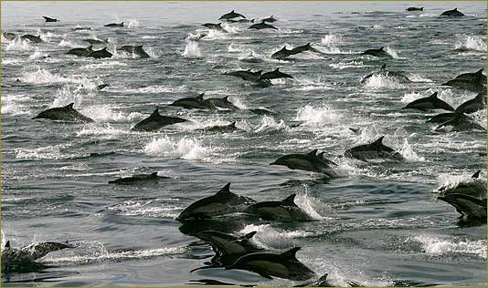
Why is this important?
We are not the only critters using sound to find our place in the ocean

Slide 21

Thank You!
www.OCR.org
Mental Insight
Marisla Foundation
Nathan Cummings Foundation
Holtheus Trust
Hawley Family Trust
Campbell Foundation

Slide 22
